Slide 1
FULL-TEXT SEARCH USING PYTHON
Project internship at Neolotex Business Solutions Pvt.Ltd
By Anusha T C and Bhavana B Hallikeri
5th Sem, CSE, AIT
Guided by Mr.Praveen Elathoor, Co-founder and CTO, Neolotex Business Solutions Pvt.ltd

Slide 2
Table of content
Introduction
Components and Interface
Why Elastic Search?
Approaches
Real-Time applications
Revenues
Conclusion
Python Script
Web-application

Slide 3

INTRODUCTION
Full-text search is a powerful tool that can be used to find information quickly and easily. It works by indexing the text of documents, so that you can search for specific terms or phrases.

Slide 4
COMPONENTS AND INTERFACE
Elastic-Search
Python
Flask-API
Open-source engine for real-time data analytics and full-text search.
Enables seamless interaction with Elasticsearch for efficient document indexing, querying, and modification in the cluster
Elasticsearch interaction via a web interface for streamlined document indexing and HTTP request handling.

Slide 5
WHY ELASTIC SEARCH ?
Efficiency
Scalability
Speed
Rich Querying
Real-Time Capabilities

Slide 6
TYPES OF APPROACHES
Two Approaches
Python Script
Web Application

Slide 7
PYTHON SCRIPT FEATURES
1.Indexing
Using folder path
2. Fetching
By index and record count
Specific document by index and keyword
By index and field name
Specific data of a document by index and field name
3.Index Operations
To add a new field to an index.
To delete a field
To alter data in a specific field
To delete an index
To add a new record to an index.

Slide 8
Web-Application FEATURES
1. Indexing
Index documents from a folder path
2. Fetching
Documents by index.
Documents by index and field name.
Documents by index and keyword
3. Index Operations
To Add a new field
To Delete a field from specific data
To Alter data in a specific field
To Delete an index
To Add a new record

Slide 9
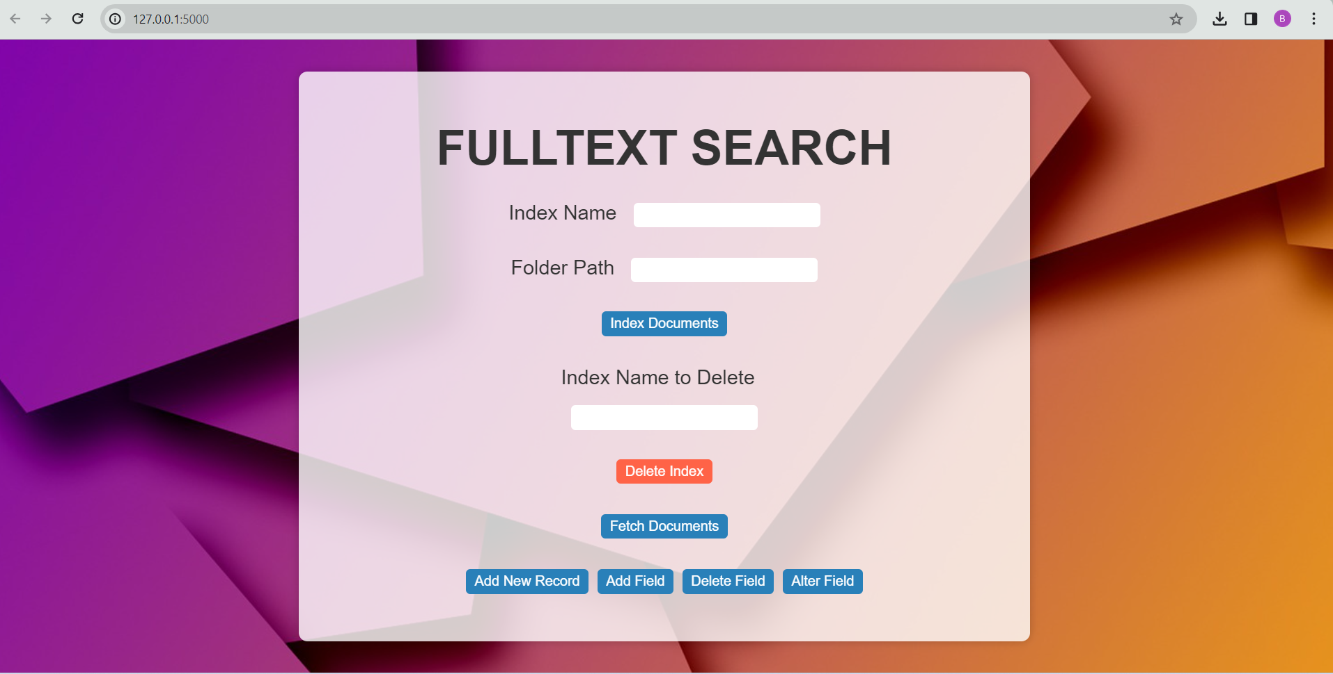

Slide 10




Real-Time Applications
E-commerce Product Search
Customer Support Ticketing
Systems
Content Management Systems
Legal Document Analysis

Slide 11




Real-Time Applications
Healthcare Records Retrieval
Codebase Searching in Software
Development
E-learning Platforms
Scientific Research Databases

Slide 12
CONCLUSION
Our utilization of Python and Elasticsearch for full text search has been highly successful. By combining Python's scripting capabilities with Elasticsearch's robust indexing, we've achieved impressive efficiency and scalability. This integration provides customization flexibility, ensuring a tailored search experience. With strong community support and reliable performance, our solution is poised to meet evolving user demands.

Slide 13
Thanks!
Do you have any questions?

